Slide 1
Lex tutorial

Slide 2
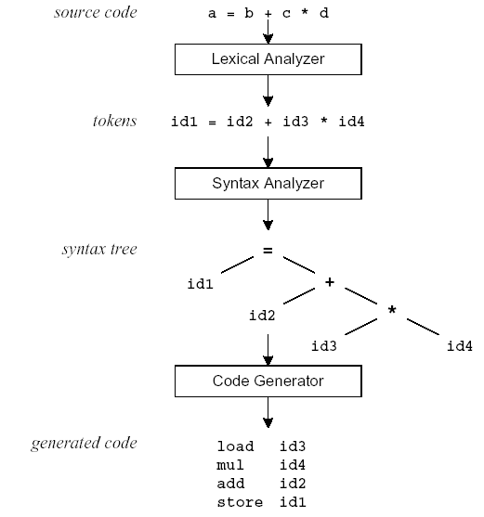
Compilation Sequence

Slide 3
What is Lex?
The main job of a lexical analyzer (scanner) is to break up an input stream into more usable elements (tokens)
  a = b + c * d;
  ID ASSIGN ID PLUS ID MULT ID SEMI
Lex is an utility to help you rapidly generate your scanners

Slide 4
Lex – Lexical Analyzer
Lexical analyzers tokenize input streams
Tokens are the terminals of a language
  English
    words, punctuation marks, …
  Programming language
    Identifiers, operators, keywords, …
Regular expressions define terminals/tokens

Slide 5
Lex Source Program
Lex source is a table of
  regular expressions and
  corresponding program fragments
digit [0-9]
letter [a-zA-Z]
%%
{letter}({letter}|{digit})* printf(“id: %s\n”, yytext);
\n printf(“new line\n”);
%%
main() {
yylex();
}

Slide 6
Lex Source to C Program
The table is translated to a C program (lex.yy.c) which
  reads an input stream
  partitioning the input into strings which match the given expressions and
  copying it to an output stream if necessary

Slide 7
An Overview of Lex
Lex source program
Lex
lex.yy.c
lex.yy.c
C compiler
a.out
input
a.out
tokens

Slide 8
Lex Source
Lex source is separated into three sections by %% delimiters
The general format of Lex source is
The absolute minimum Lex program is thus
{definitions}
%%
{transition rules}
%%
{user subroutines}
(required)
(optional)
%%

Slide 9
Lex Regular Expressions (Extended Regular Expressions)
A regular expression matches a set of strings
Regular expression
  Operators
  Character classes
  Arbitrary character
  Optional expressions
  Alternation and grouping
  Context sensitivity
  Repetitions and definitions

Slide 10
Pattern Matching Primitives
Metacharacter | Matches
. | any character except newline
\n | newline
* | zero or more copies of the preceding expression
+ | one or more copies of the preceding expression
? | zero or one copy of the preceding expression
^ | beginning of line / complement
$ | end of line
a|b | a or b
(ab)+ | one or more copies of ab (grouping)
[ab] | a or b
a{3} | 3 instances of a
“a+b” | literal “a+b” (C escapes still work)

Slide 11
Lex Predefined Variables
yytext -- a string containing the lexeme
yyleng -- the length of the lexeme
yyin -- the input stream pointer
  the default input of default main() is stdin
yyout -- the output stream pointer
  the default output of default main() is stdout.
cs20: %./a.out < inputfile > outfile
E.g.
  [a-z]+ printf(“%s”, yytext);
  [a-z]+ ECHO;
  [a-zA-Z]+ {words++; chars += yyleng;}

Slide 12
Lex Library Routines
yylex()
  The default main() contains a call of yylex()
yymore()
  return the next token
yyless(n)
  retain the first n characters in yytext
yywarp()
  is called whenever Lex reaches an end-of-file
  The default yywarp() always returns 1

Slide 13
Review of Lex Predefined Variables
Name | Function
char *yytext | pointer to matched string
int yyleng | length of matched string
FILE *yyin | input stream pointer
FILE *yyout | output stream pointer
int yylex(void) | call to invoke lexer, returns token
char* yymore(void) | return the next token
int yyless(int n) | retain the first n characters in yytext
int yywrap(void) | wrapup, return 1 if done, 0 if not done
ECHO | write matched string
REJECT | go to the next alternative rule
INITAL | initial start condition
BEGIN | condition switch start condition

Slide 14
User Subroutines Section (cont’d)
The section where main() is placed
%{
int counter = 0;
%}
letter [a-zA-Z]
%%
{letter}+ {printf(“a word\n”); counter++;}
%%
main() {
yylex();
printf(“There are total %d words\n”, counter);
}

Slide 15
Usage
To run Lex on a source file, type
lex scanner.l
It produces a file named lex.yy.c which is a C program for the lexical analyzer.
To compile lex.yy.c, type
cc lex.yy.c –ll
To run the lexical analyzer program, type
./a.out < inputfile

Slide 16
Introduction
What is YACC ?
  Tool which will produce a parser for a given grammar.
  YACC (Yet Another Compiler Compiler) is a program designed to compile a LALR(1) grammar and to produce the source code of the syntactic analyzer of the language produced by this grammar.

Slide 17
How YACC Works
gram.y
File containing desired
grammar in yacc format
yacc
yacc program
y.tab.c
C source program created by yacc
cc
or gcc
C compiler
a.out
Executable program that will parse
grammar given in gram.y

